Slide 1
Udacity
Marketing Analytics
Nanodegree Program
Project: Craft a Report
BY: saksham taneja

Slide 2
Part 1: Objective Results

Slide 3
What were our Objectives?
Objective 1: hike in total sales by 30% on Black Friday 2018 vs. 2017. Objective 2: Decrease in total ad spend by 30% from Black Friday 2017 to 2018.

Slide 4
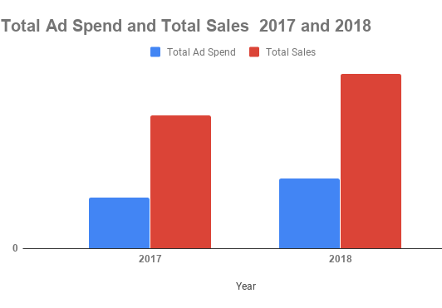
Objective Results
Year | Total Ad Spend | Total Sales
2017 | 607,601 | 1594913.85
2018 | 837155.55 | 2092431.46
Growth | 37.78% | 31.19%
objective Increase total sales by 30% on Black Friday 2018 vs. 2017.
goal was met as total sales grow 31.19% from 2017 to 2018.
Decrease total ad spend by 30% from Black Friday 2017 to 2018.
goal was not met as ad spend increased by 37.78% from 2017 to 2018

Slide 5
Part 2: Evaluate the Audience

Slide 6
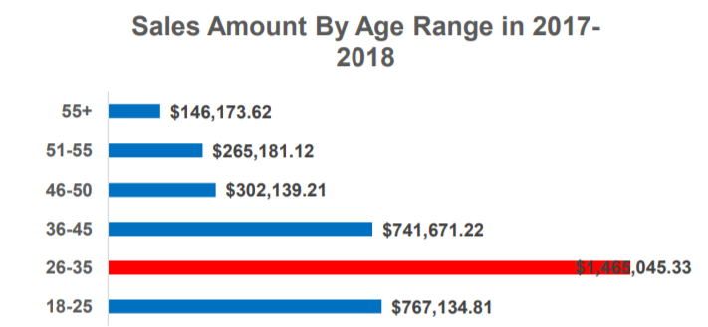
Which Age range generated the most sales?
Sales by age range?
Most of the sale is generated by people of age 26-35 of amount $1,465,045
Second highest sale is generated by 18-25 of amount $741,671

Slide 7
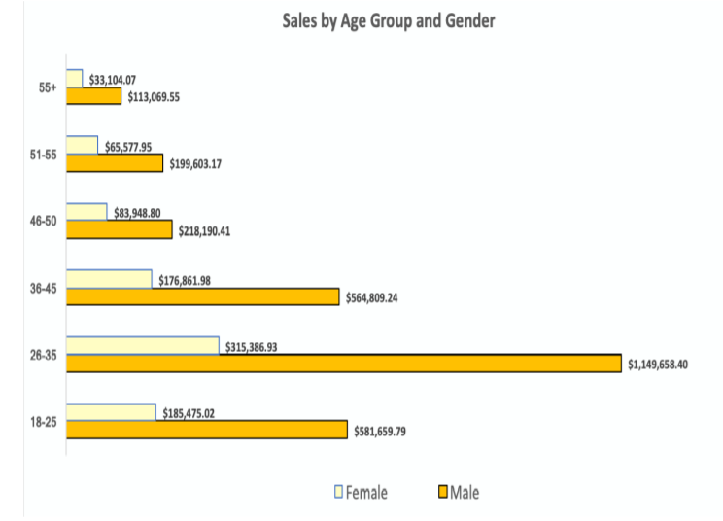
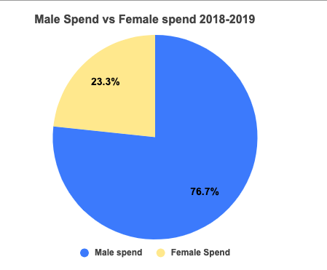
Who spent more? Men or Women?
76.7% of total spend is done by male and across all age mens spend more than women where women spend of total spend is 23.3%

Slide 8
Part 3: Evaluate the Marketing

Slide 9

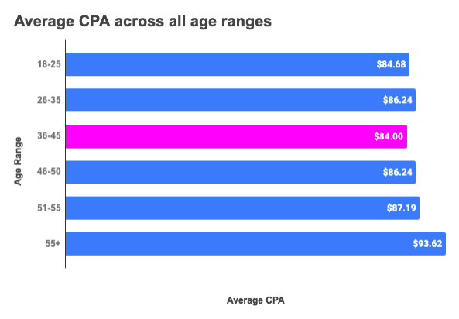
Which age-range had the best CPA? Was our ROI Positive or negative?
Was the ROI on our Paid Channel positive or negative? Which agerange had the best CPA?
7.26% is the ROI which shows a positive ROI Age range of 36-45 has best CPA
Total Sale | Total CPA | ROI | Formula
1,549,620.54 | 1,444,765.96 | 7.26% | =(A2-B2)/B2
*ROI = (total sales – total cost)/total cost *100
Age range 55+ had the highest CPA at $94.31

Slide 10
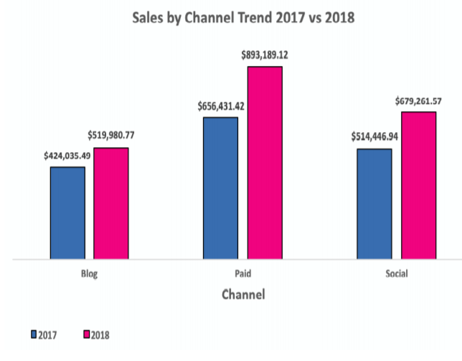
Demonstrate total sales by channel
Which channel was the biggest sales for 2017? For 2018?
Paid channels is having biggest sale for both year 2017, 2018
Blog Total sales: $944,016
Social Media Total sales: $1,193,709
Paid channels Total sales: 1,549,621

Slide 11

Part 4: Evaluate the Sales

Slide 12
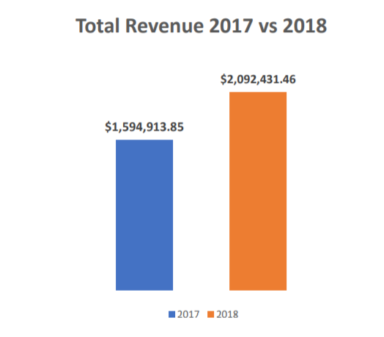
How much revenue did we generate in 2017? In 2018?
How much revenue did we generate in 2017? In 2018?
total revenue was $1,594,914 In 2017,
total revenue was $2,092,431 in 2018

Slide 13

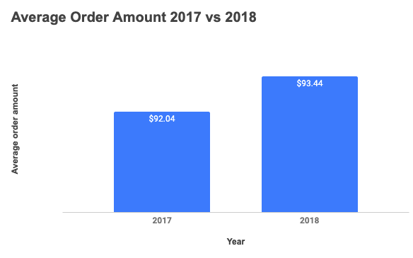
What was our average order amount in 2017 vs 2018?
What was our average order amount in 2017 vs 2018?
average order amount was $92.04 In 2017,
while average order amount was $93.44 in 2018

Slide 14
Part 5: Evaluate the Product Categories

Slide 15
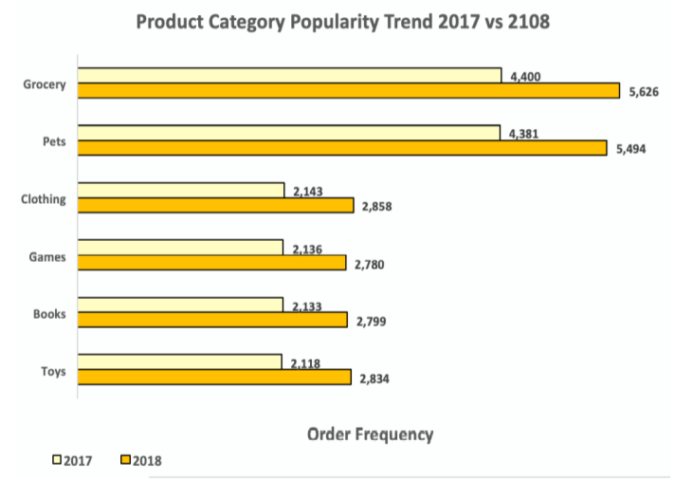
Which product category was most popular in 2017 & 2018?
Grocery were the most popular item with 4400 units sold In 2017,
while, Grocery in 2018 was also the most popular item with a total of 5626 units sold

Slide 16
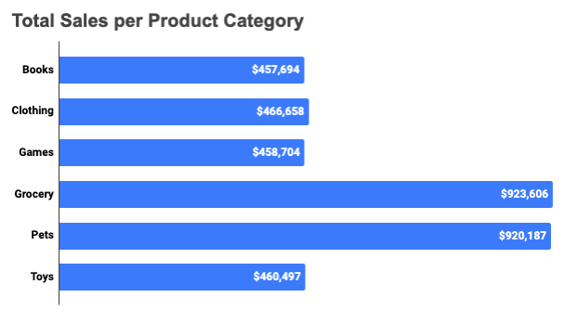
Demonstrate sales by product category
Grocery had the highest amount of sales with total sales of $923,606 And next with Pets having total sales of $920,187
The two least performing product categories were Games with total sale $458,704 and Books with total sales of $457,694

Slide 17
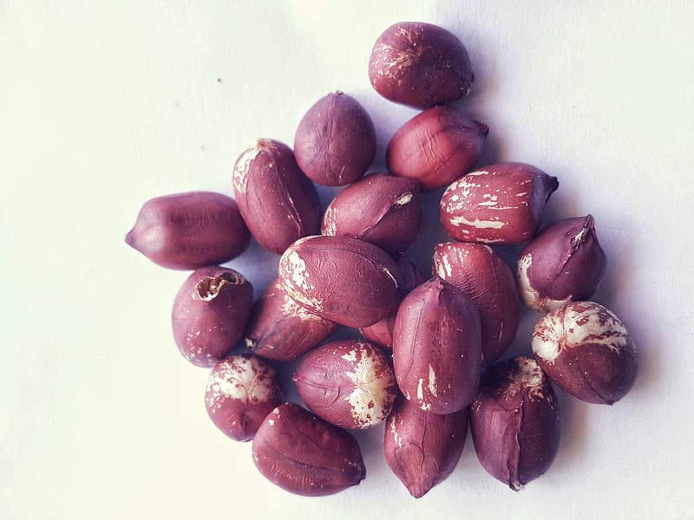
Everything else?
Udacity content
Udacity mentors
Google.com
Dataset given by team

Slide 18


